Slide 1
Exit
Sludge Treatment
Units for Rent
Service
Polymer Equipment
Company
Thickening units
Dewatering units
Polymer units
revision 1.0

Slide 2
IRISH SALES AGENT data- Contact Val W Stone

Slide 3
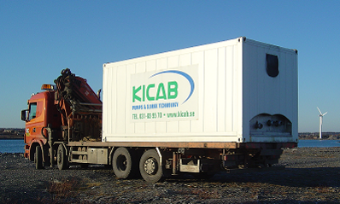
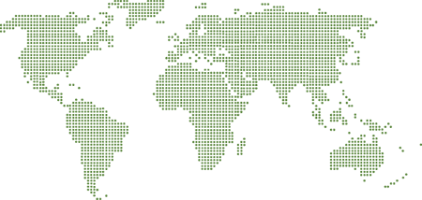
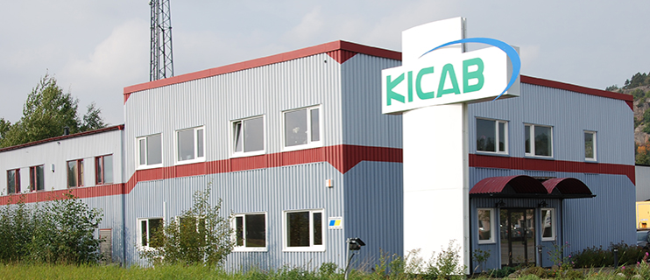
Exit
The Company
KICAB is an engineering and manufacturing company that provides innovative solutions and services for water and wastewater treatment.
We offer turn-key, tailor-made plants that are optimized to give the best technical packages for the lowest capital and running cost.
Founded 2003
Customer Focus
In-house Engineering
Full-scale Laboratory
Sludge Dewatering
Units for Rent
Service
Polymer Equipment
KICAB serves clients worldwide through the main office in Sweden.
Scandinavia
Sweden
Norway
Denmark
Finland
Other contries
Vietnam
Korea
Thailand
Turkey
USA
Flexible company with high experience in design engineering, sludge treatment and chemicals.
For every case of application, we offer a solution ready to use; Mobile or Stationary.
Designed in a wide range of sizes, suitable for both small and large applications.
Applications
Water
Wastewater
Chemical
Paper
Pulp
Biogas industries
Tell us your requirements and KICAB can recommend a solution to match your specific needs.
Thickener units
Dewatering units
Polymer units

Slide 4
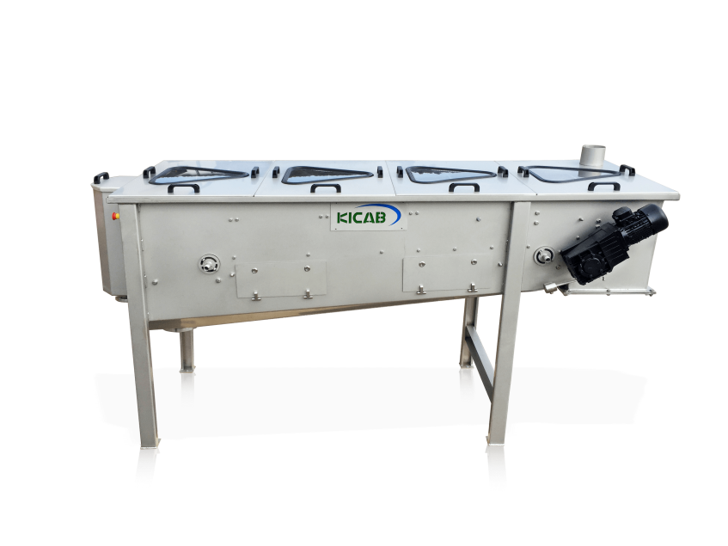
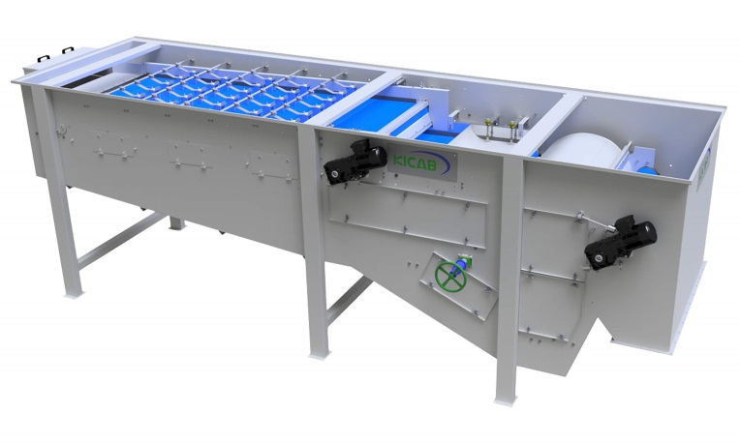
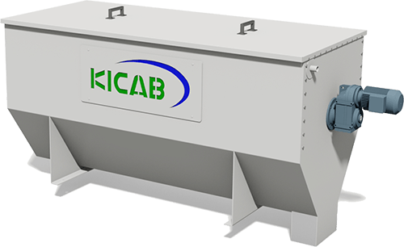
Exit
SALTEC
Product Range
Thickener units
SALTEC Belt Thickener
SALTEC Single Belt Press
SALTEC Drum Thickener
Company
Dewatering units
Polymer units
Options

Slide 5
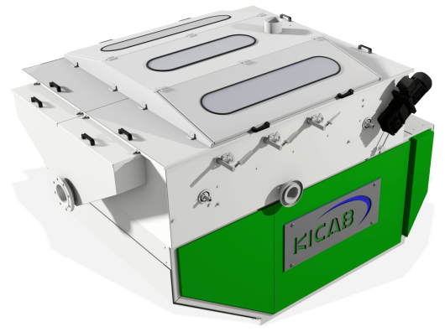
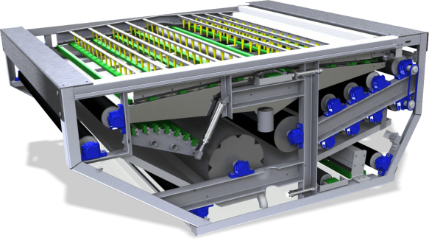
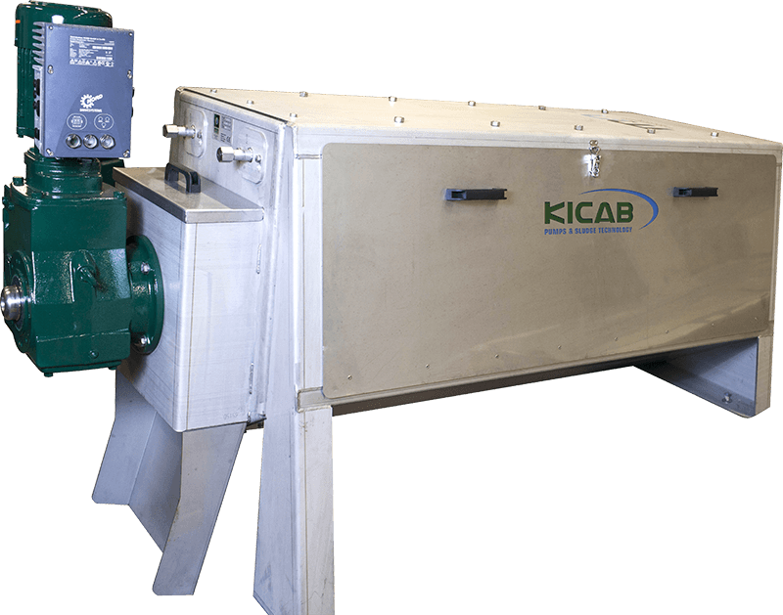
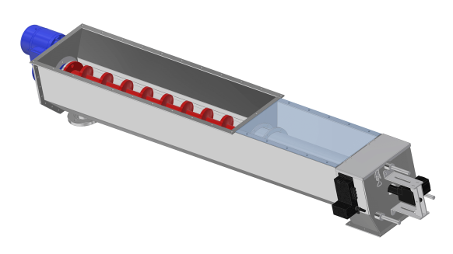
Exit
SALTEC
Product Range
Dewatering units
SALTEC Belt Filter Press
SALTEC Combo
Disc Press QS
SALTEC Screw Press
Company
Thickener units
Polymer units

Slide 6
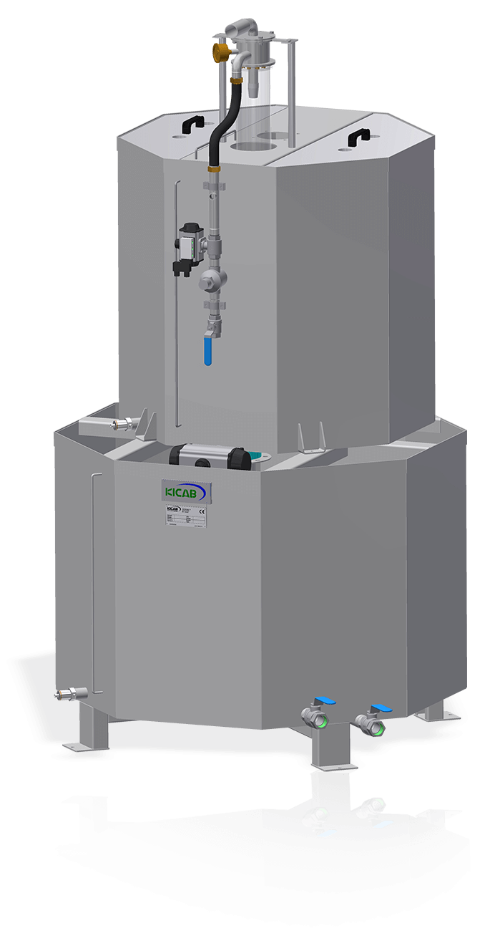
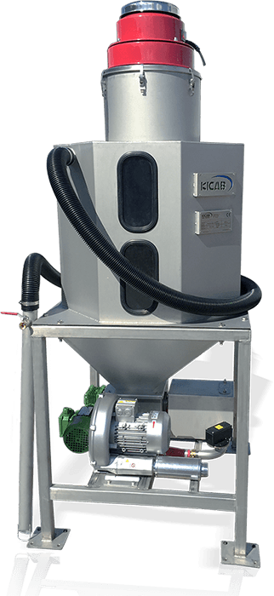
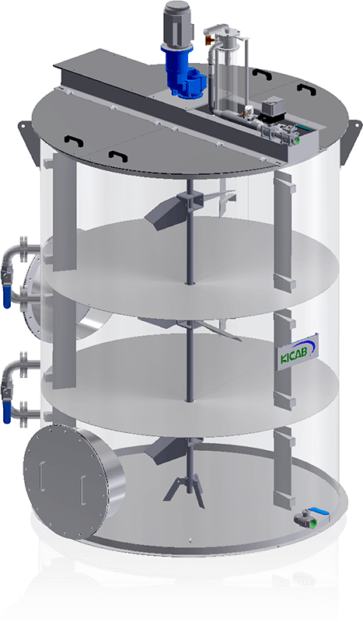
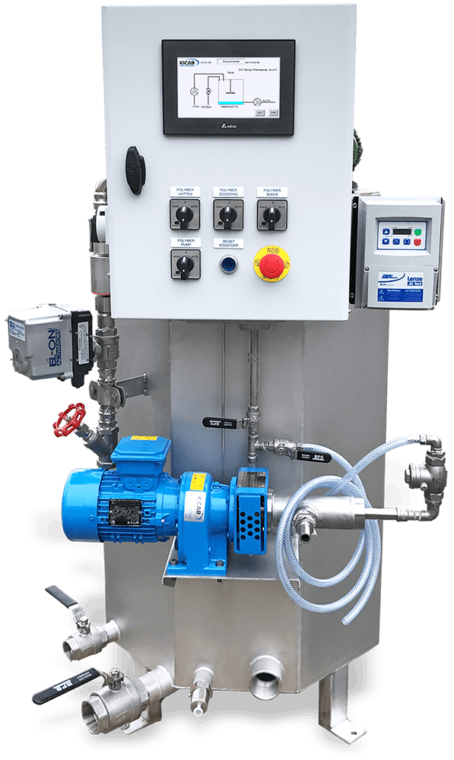
Exit
SALTEC
Product Range
Polymer units
Double Tank System
Liquid Polymer System
SBS Suction unit
Continuous Polymer System
Company
Thickener units
Dewatering units
Options

Slide 7
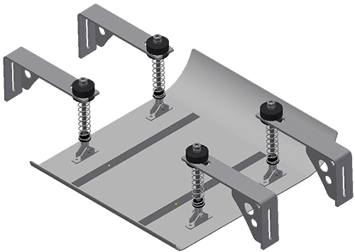
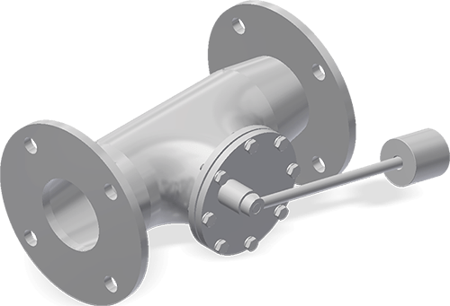
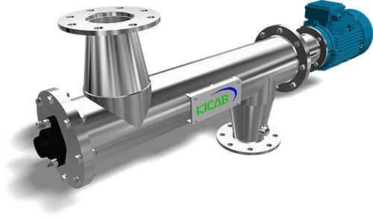
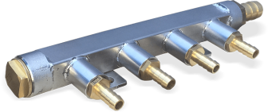
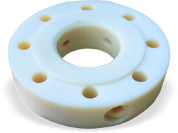
Exit
SALTEC
Product Range
Thickener units
Accessories options
Sludge Sled
Polymer flange with divisive
Sludge Mixer
Dynamic Mixer
Company
Thickener units
Dewatering units
Polymer units
Options

Slide 8
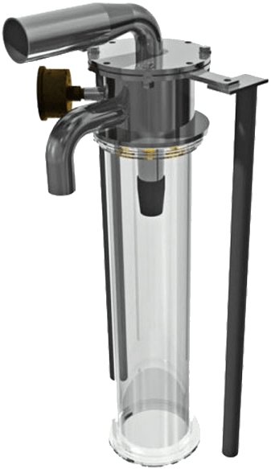
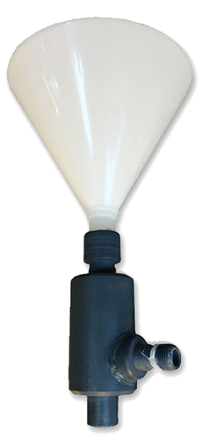
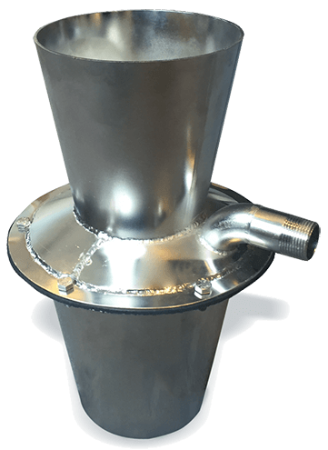
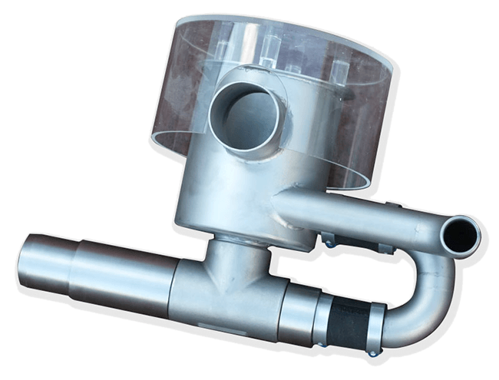
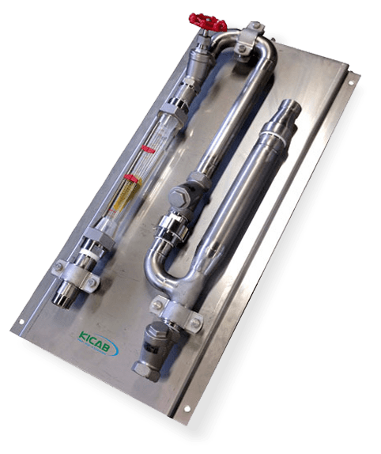
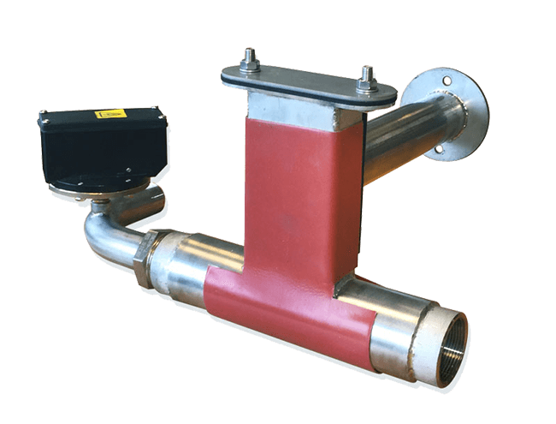
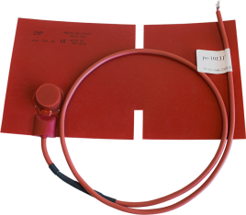
Exit
SALTEC
Product Range
Polymer units
Accessories options
PolyWet
Polymer Eductor
Heated Cone
Diluting Water Board
AeroWet & Heating mat
Company
Thickener units
Dewatering units
Polymer units
Options

Slide 9
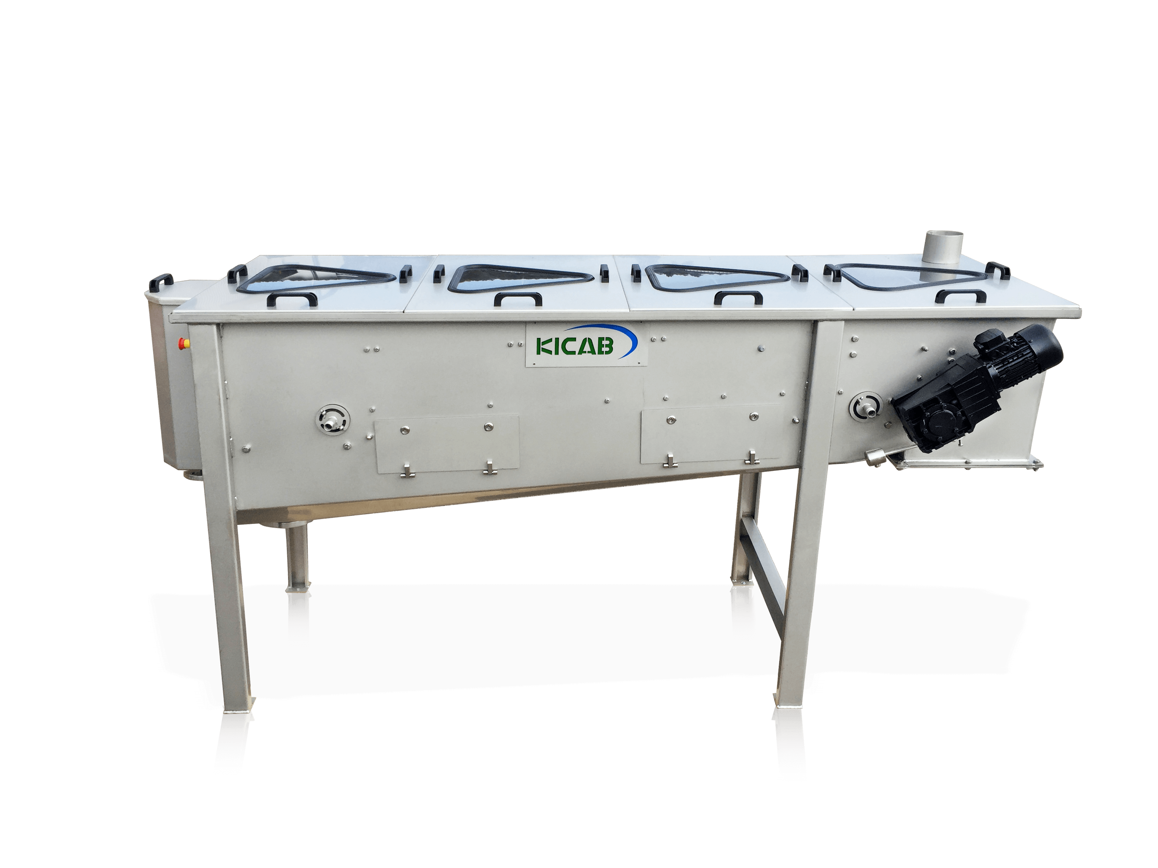
Exit
SALTEC Belt Thickener - SBT
Mechanical thickener for dewatering of municipal and industrial wastewater.
Highly effective dewatering unit with excellent result.
Features
Compact, Automatic, Hygienic, CE approved.
Easy maintenance and accessibility.
Fully enclosed ventilated system to eliminate aerosol and odour.
Low consumption of resources - Polymer, Energy, Water.
Effective design and manufacturing with the best materials available.
High quality equipment completely in stainless steel.
Thickener units
Dewatering units
Polymer units
Overview
Tech Spec.
Flow Chart
Case Stories

Slide 10
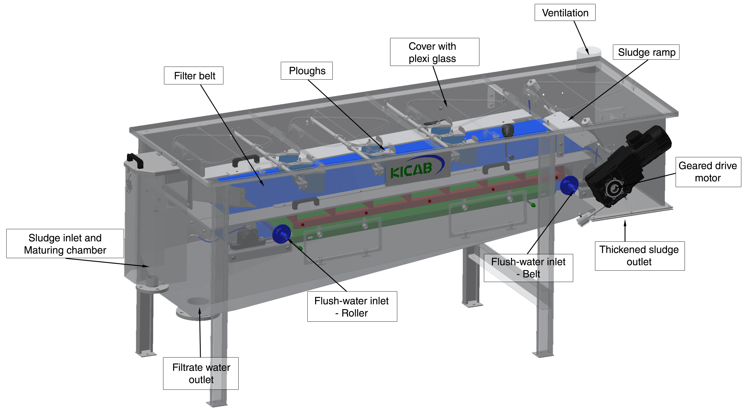
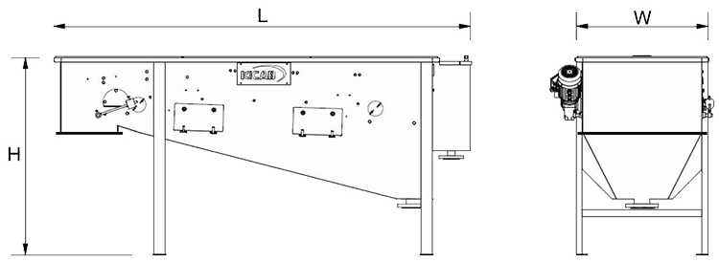
Exit
SALTEC Belt Thickener - SBT
Technical Specifications
Model | Length [ mm ] | Width [ mm ] | Height [ mm ] | Capacity [ m3/h] | DS-Out [ % ] | Power [ kW ]
SBT 30m | 1700 | 600 | 1250 | 0,5 – 3 | 4 – 12 | 0,55
SBT 30 | 2800 | 700 | 1250 | 3 – 5 | 4 – 12 | 0,55
SBT 50m | 2000 | 800 | 1250 | 4 – 8 | 4 – 12 | 0,55
SBT 50 | 2800 | 800 | 1250 | 5 – 10 | 4 – 12 | 0,55
SBT 70 | 2800 | 1000 | 1250 | 10 – 25 | 4 – 12 | 0,55
SBT 70L | 3200 | 1000 | 1250 | 15 – 35 | 4 – 12 | 0,75
SBT 90 | 2800 | 1200 | 1250 | 25 – 40 | 4 – 12 | 0,55
SBT 90L | 3200 | 1200 | 1250 | 35 – 50 | 4 – 12 | 0,75
SBT 120 | 2800 | 1500 | 1250 | 40 – 70 | 4 – 12 | 0,75
SBT 120L | 3200 | 1500 | 1250 | 50 – 80 | 4 – 12 | 1,5
SBT 120XL | 3500 | 1500 | 1250 | 80 – 90 | 4 – 12 | 1,5
SBT 170 | 2800 | 2000 | 1250 | 70 – 90 | 4 – 12 | 0,75
SBT 170XL | 3500 | 2000 | 1250 | 90 – 120 | 4 – 12 | 1,5
SBT 220 | 2800 | 2500 | 1250 | 90 – 120 | 4 – 12 | 1,5
SBT 220L | 3200 | 2500 | 1250 | 120 – 150 | 4 – 12 | 1,5
SBT 270 | 2800 | 3000 | 1250 | 120 – 180 | 4 – 12 | 1,5
SBT 270L | 3200 | 3000 | 1250 | 150 – 200 | 4 – 12 | 1,5
Thickener units
Dewatering units
Polymer units
Overview
Tech Spec
Flow Chart
Case Stories

Slide 11
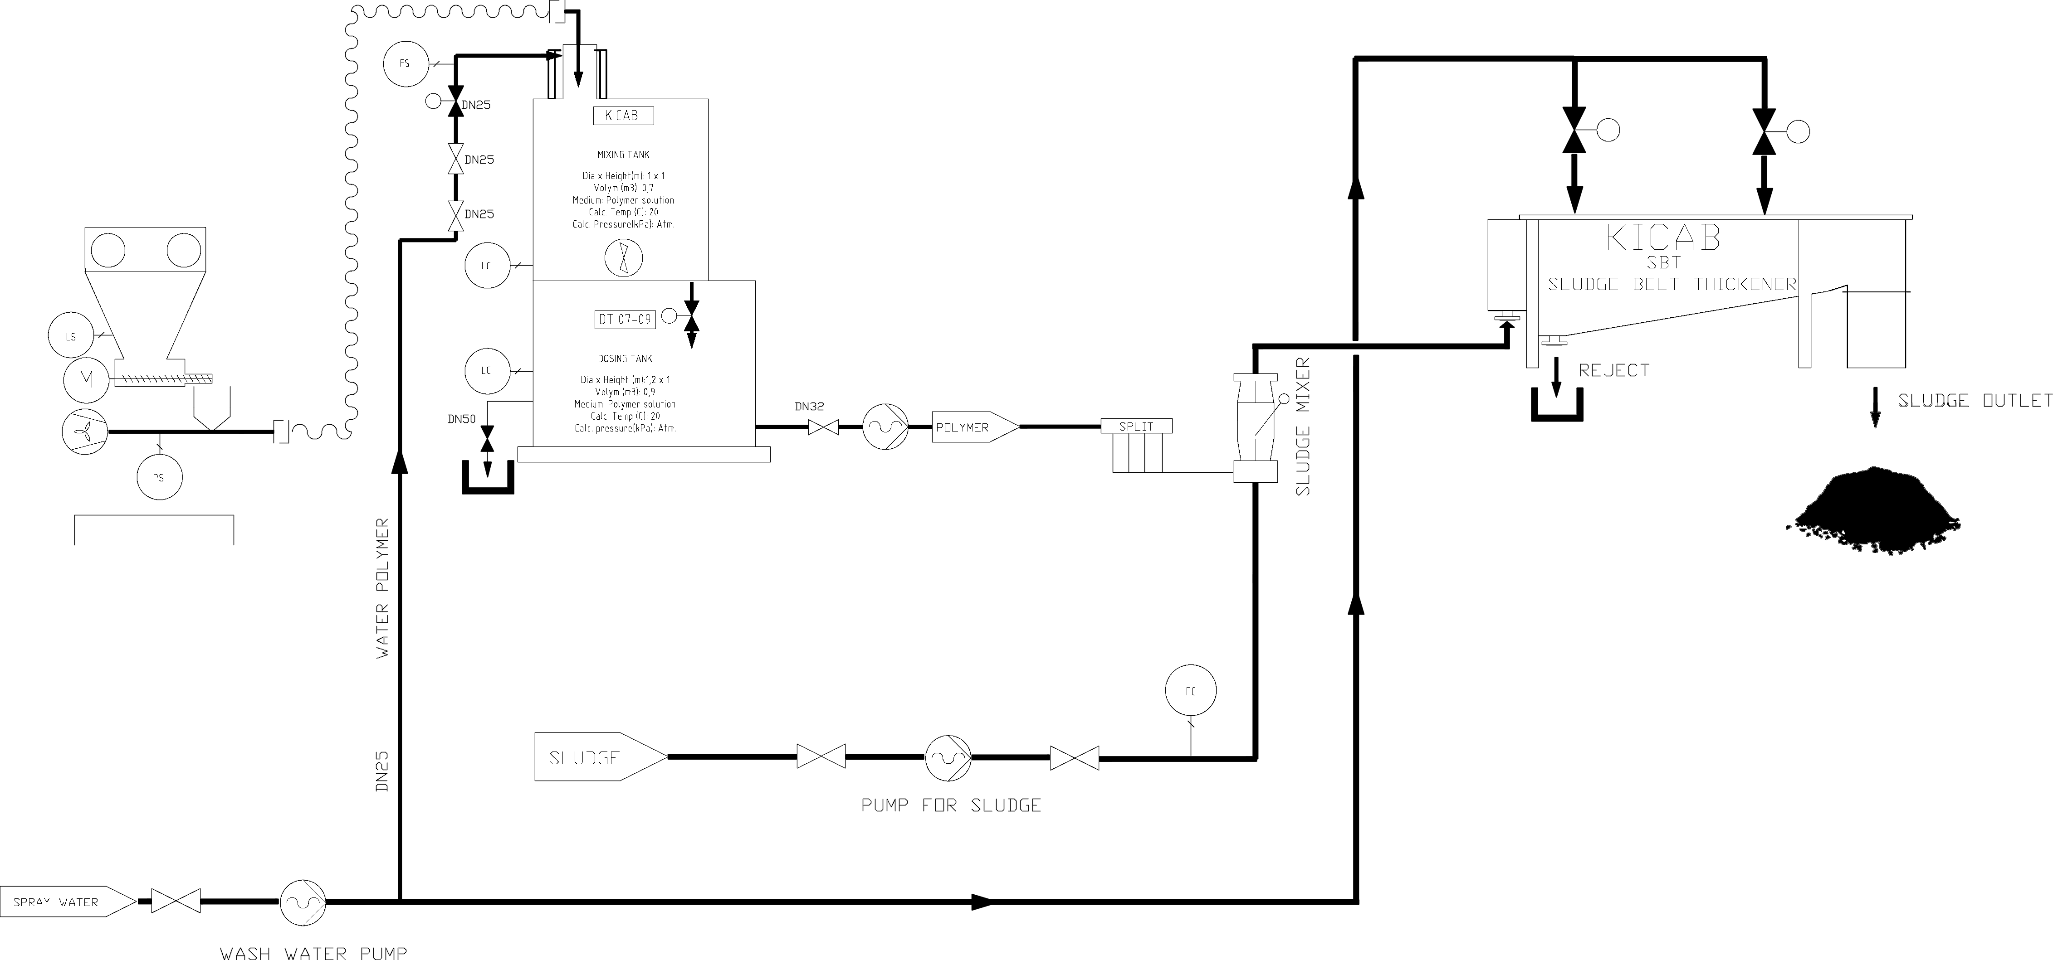
Exit
SALTEC Belt Thickener - SBT
Flow chart
Thickener units
Dewatering units
Polymer units
Overview
Tech Spec
Flow Chart
Case Stories

Slide 12
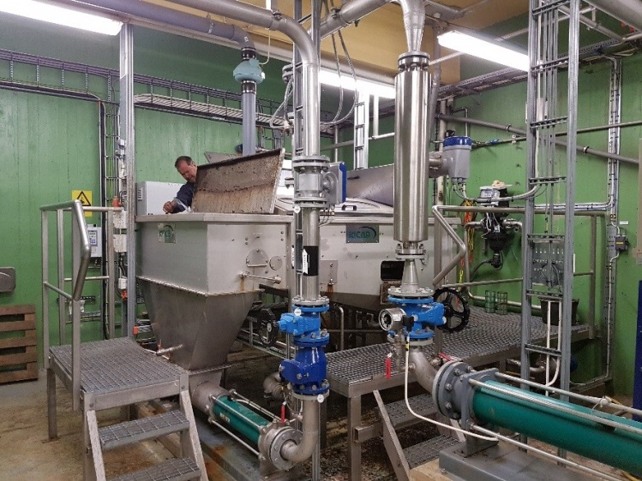
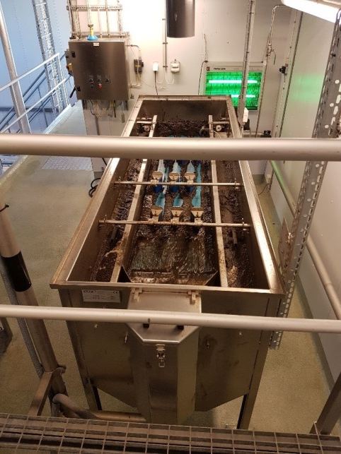
Exit
SALTEC Belt Thickener - SBT
Case stories
SBT 120
SBT 70
Customer: Trelleborg municipal sewage plant
Installed: 2012
Position: Sludge from simultanius precipitated bio step to digester.
Performance:
Q- inlet: 10 – 15 m3/ hour 200 – 375 kg DS/ hour
DS in: 2 - 2,5 % DS out: 8 – 10% normally < 6 % due to process.
Reject: < 500 mg/l
Customer: Lerkil municipal sewage plant
Installed: 201?
Position: Biological sludge from SBR
Thickener units
Dewatering units
Polymer units
Overview
Tech Spec
Flow Chart
Case Stories

Slide 13
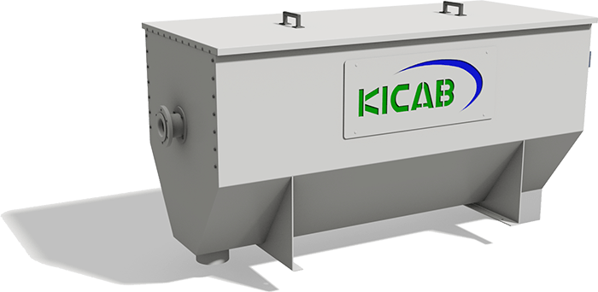
Exit
SALTEC Drum Thickener - KDT
SALTEC Rotary Drum Thickener model KDT with perforated stainless steel drum and internal shaftless screw for sludge thickening / pre-dewatering.
Features
Compact, Automatic, Hygienic, CE approved.
Thickening of municipal or industrial wastewater sludge.
Thickening of sludge for landfill or other forms of disposal, suitable for small wastewater treatment plants.
Thickening before anaerobic digestion.
Thickening before a belt press or centrifuge - a combined system improves the mass load capacity of the dewatering machine.
Thickening before a belt filter press.
Thickener units
Dewatering units
Polymer units
Overview
Tech Spec.

Slide 14
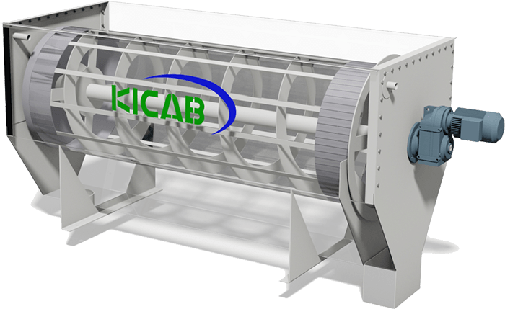
Exit
SALTEC Drum Thickener - KDT
Technical Specifications
Model | Capacity [ kg/h ]
KDT 15 | 150 – 250
KDT 30 | 300 – 450
KDT 35 | 600 – 1100
The Drum Thickener is capable of thickening sludge content From: 5 - 30% To: 5 - 800kg DS/h
Thickener units
Dewatering units
Polymer units
Overview
Tech Spec.

Slide 15
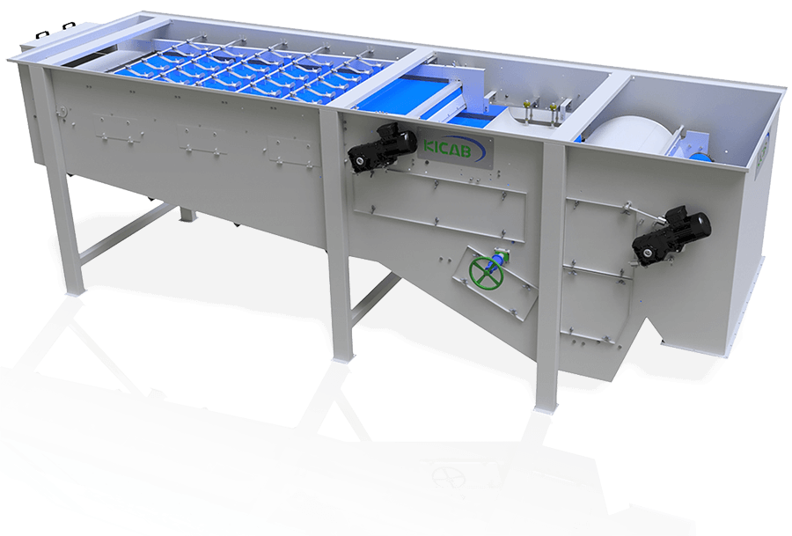
Exit
SALTEC Single Belt Press - SBP
A state-of-the-art press that combines the features of both a belt thickener and a belt filter press with high capacity, performance and reliability.
Specifically developed for continuous operation, high hydraulic throughput, low polymer usage, low maintenance, and long operational life in the highly corrosive environment of waste treatment.
Features
Multi-stage dewatering.
Large gravity thickening area for pre-dewatering.
Externally adjustable self-clearing plows.
High pressure zone with up to 8 press rollers.
Maximum filtrate quality.
Compact and enclosed design to eliminate aerosol and odour.
Thickener units
Dewatering units
Polymer units
Overview
Tech Spec
Case stories

Slide 16
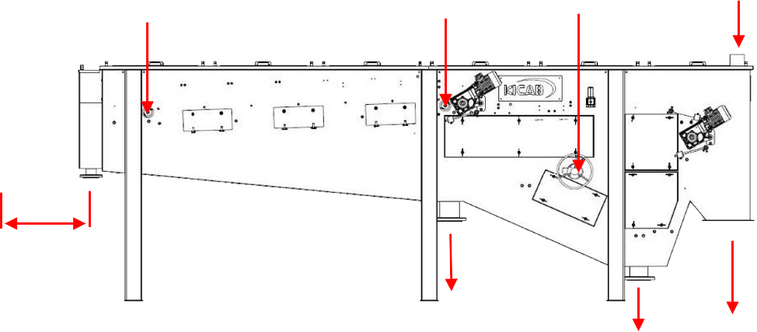
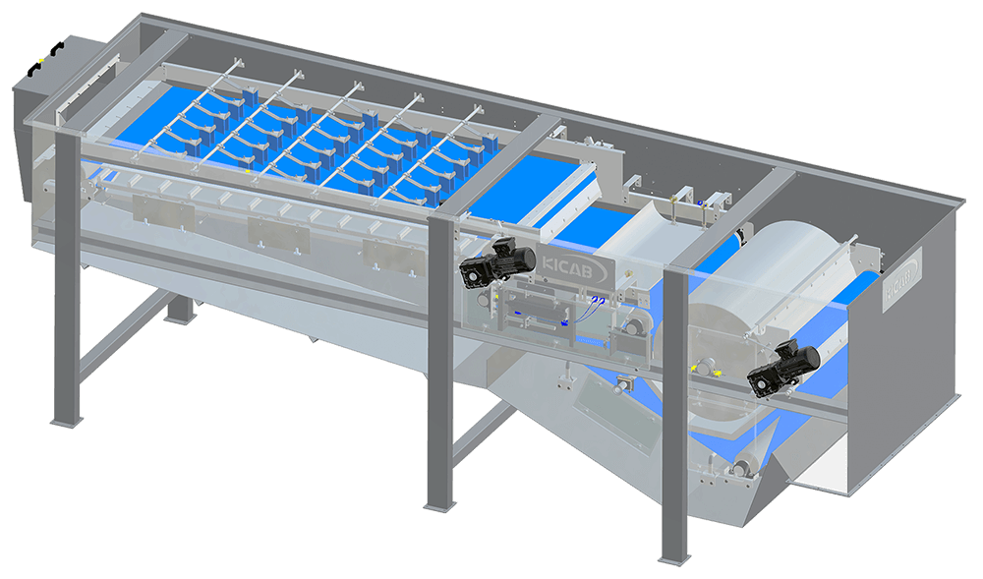
Exit
SALTEC Single Belt Press - SBP
Technical Specifications
Flush water pipe
-Roller
Flush water pipe
-Upper belt
STAMM
flush pipe
Ventilation
Maturing chamber
Sludge inlet
Ploughs
Filter belt
Ramp
Sled
Sludge mixer
Drum roller
Min. 2-5m
Filtrate water outlet
Dewatered sludge outlet
Filtrate water outlet
Model | Length [ mm ] | Width [ mm ] | Height [ mm ] | Weight [ kg ] | Power [ kW] | Capacity [ m3/h ] | DS-Out [ % ]
SBP 90XL | 5870 | 1360 | 2100 | 1100 | 1,85 | 5 – 25 | 12 – 20
SBP 120XL | 5870 | 1660 | 2100 | 1400 | 1,85 | 15 – 40 | 12 – 20
SBP 200XL | 5870 | 2460 | 2100 | 1900 | 2,60 | 40 – 75 | 12 – 20
Pneumatic belt tension
Thickener units
Dewatering units
Polymer units
Overview
Tech Spec
Case stories

Slide 17
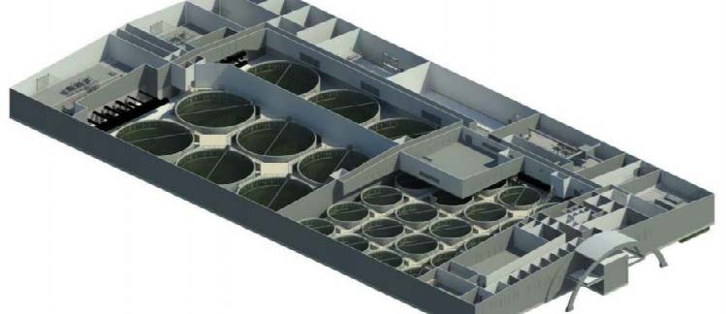
Exit
SALTEC Single Belt Press - SBP
Case stories
Customer: Helgeland smolt - Norway
Equipment: 2 lines of sludge dewatering before drying unit.
Description Line 1: SBT 120XL dewatering table 1200mm with sludge sled + screw press.
Description Line 2: SBP 120 dewatering table with one press section.
Results after startup and first optimization:
Line 1: Capacity: 80 m3/h Dry substance: 18% Reject: 150mg/l
Line 2: Capacity: 80 m3/h Dry substance: 20% Reject: 50mg/l
Thickener units
Dewatering units
Polymer units
Overview
Tech Spec
Case stories

Slide 18
Exit
SALTEC Combo - SCP
A state-of-the-art press that combines the features of both a belt thickener and a belt filter press with high capacity, performance and reliability.
Specifically developed for continuous operation, high hydraulic throughput, low polymer usage, low maintenance, and long operational life in the highly corrosive environment of waste treatment.
Features
Multi-stage dewatering.
Large gravity thickening area for pre-dewatering.
Externally adjustable self-clearing plows.
High pressure zone with up to 8 press rollers.
Maximum filtrate quality.
Compact and enclosed design to eliminate aerosol and odour.
Thickener units
Dewatering units
Polymer units
Overview
Tech Spec
Flow Chart

Slide 19
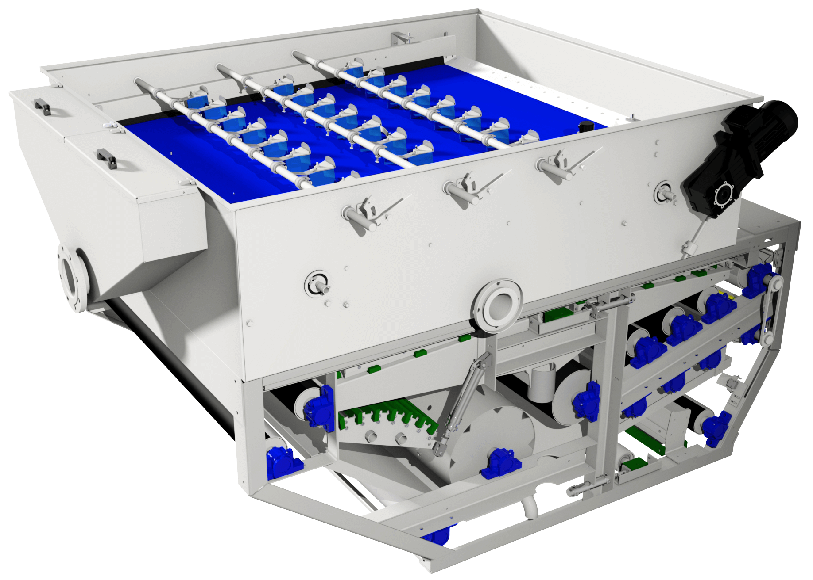
Exit
SALTEC Combo - SCP
Technical Specifications
Model | Length [ mm ] | Width [ mm ] | Height [ mm ] | Weight [ kg ] | Power [ kW ] | DS-Out [ % ]
SCP 12 | 3500 | 1690 | 2550 | 2200 | 1,5 | 20 – 25
SCP 16 | 3500 | 2090 | 2550 | 3200 | 1,5 | 20 – 25
SCP 20 | 3500 | 2490 | 2550 | 4200 | 2,2 | 20 – 25
SCP 23 | 3500 | 2790 | 2550 | 4500 | 2,2 | 20 – 25
SCP 26 | 3500 | 3090 | 2550 | 5000 | 3,0 | 20 – 25
Thickener units
Dewatering units
Polymer units
Overview
Tech Spec
Flow Chart

Slide 20
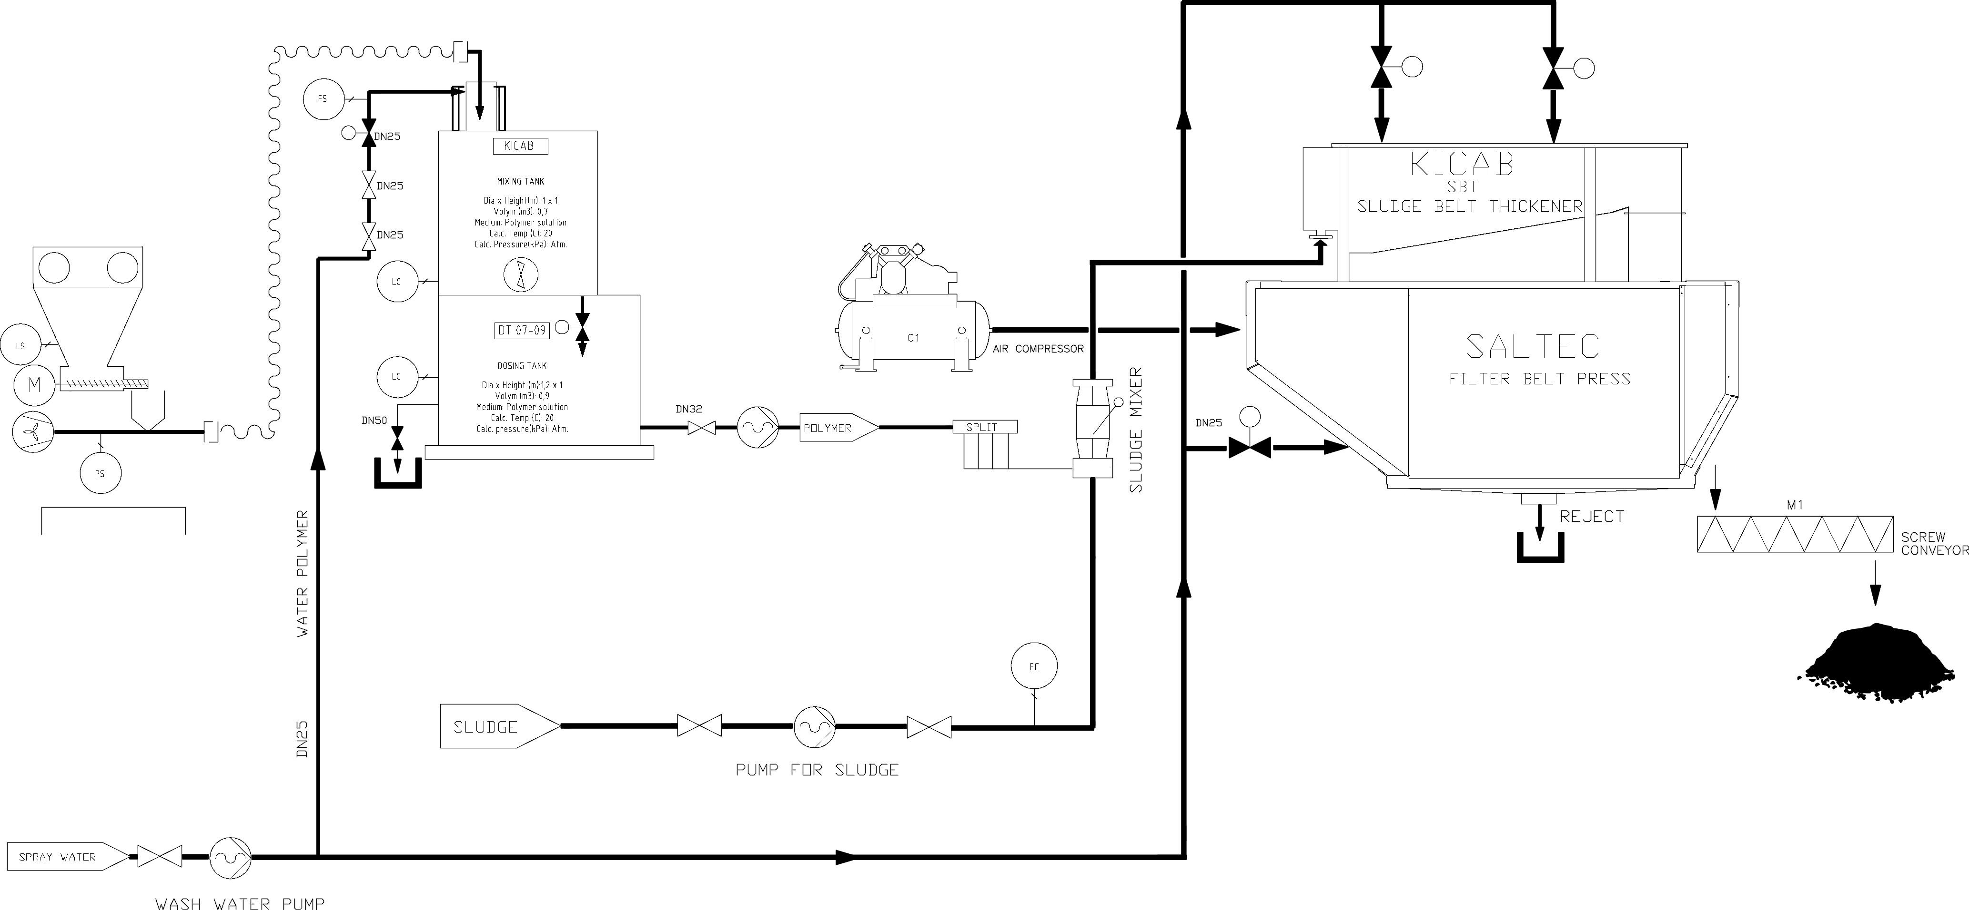
Exit
SALTEC Combo - SCP
Flow chart
Thickener units
Dewatering units
Polymer units
Overview
Tech Spec
Flow Chart

Slide 21
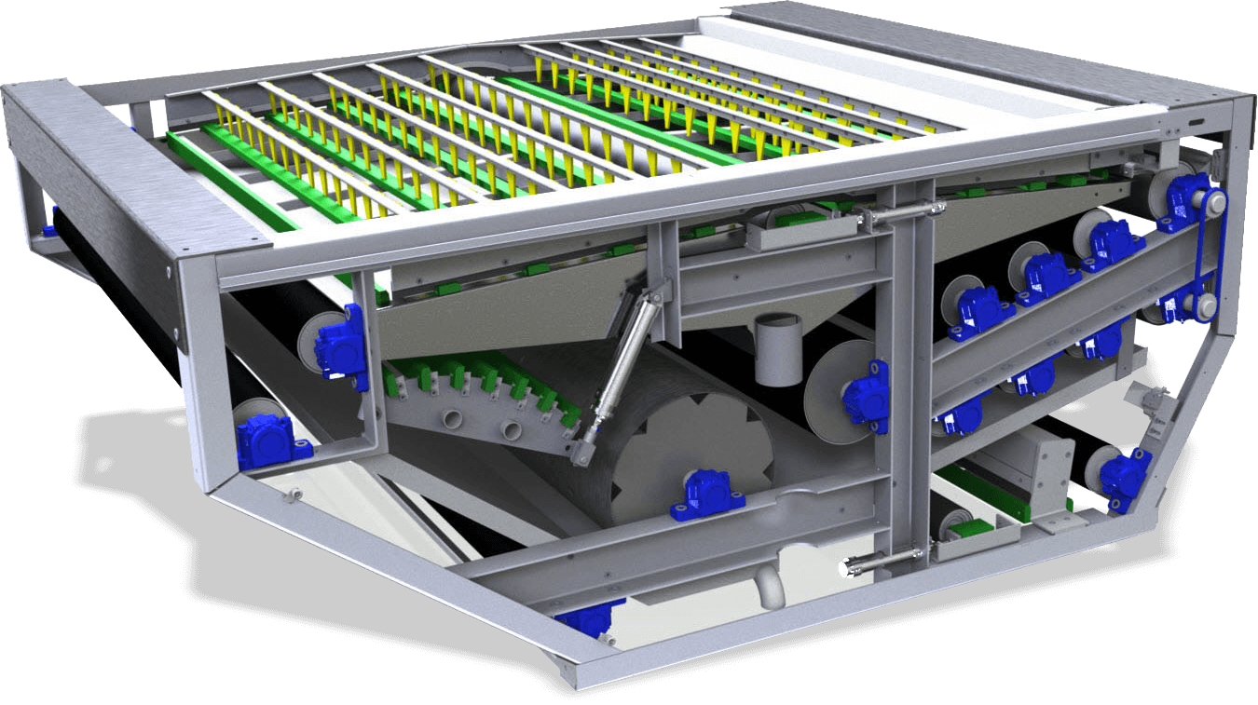
Exit
SALTEC Belt Filter Press - CP
Mechanical thickener for dewatering of municipal and industrial wastewater.
Highly effective dewatering unit with excellent result.
Features
High capacity, performance and reliability.
High dewatering performance by ideal arrangement of the rollers and high pressing.
Low cost for operation and maintenance.
Low wear and noise operation.
High pressure zone with up to 8 press rollers.
Compact and enclosed design to eliminate aerosol and odour.
Thickener units
Dewatering units
Polymer units
Overview
Tech Spec
Flow Chart

Slide 22
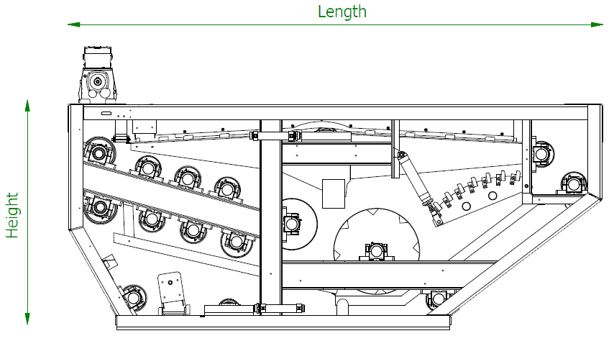
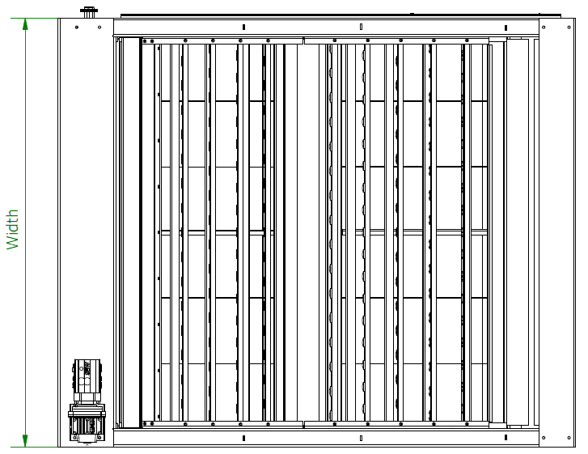
Exit
SALTEC Belt Filter Press - CP
Technical Specifications
Model | Length [ mm ] | Width [ mm ] | Height [ mm ] | Capacity [ m3/h] | DS-Out [ % ] | Power [ kW ]
CP 1200F | 2830 | 1690 | 1550 | 8 – 10 | 17 – 20 | 1,5
CP 1600F | 2830 | 2090 | 1550 | 10 – 12 | 17 – 20 | 1,5
CP 2000F | 2830 | 2490 | 1550 | 12 – 15 | 18 – 21 | 2,2
CP 2300F | 2830 | 2790 | 1550 | 15 – 18 | 18 – 21 | 2,2
CP 2600F | 2830 | 3090 | 1550 | 18 – 22 | 18 – 21 | 3,0
Thickener units
Dewatering units
Polymer units
Overview
Tech Spec
Flow Chart

Slide 23
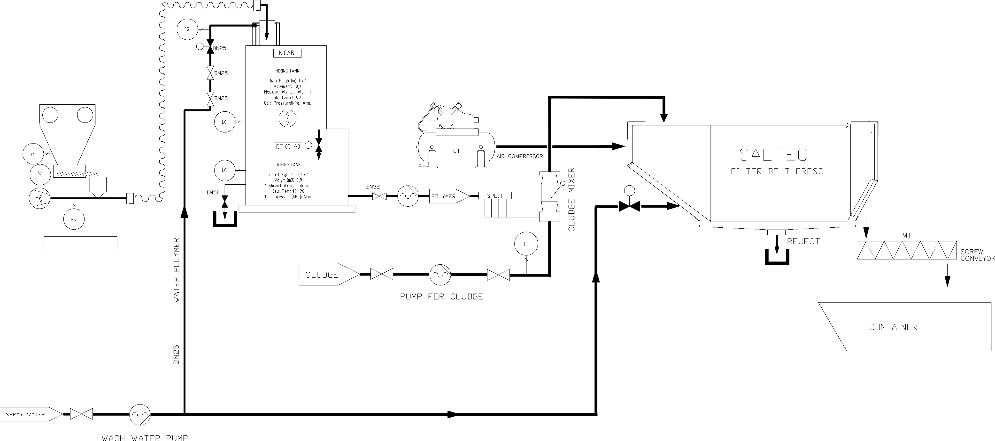
Exit
SALTEC Belt Filter Press - CP
Flow chart
Thickener units
Dewatering units
Polymer units
Overview
Tech Spec
Flow Chart

Slide 24
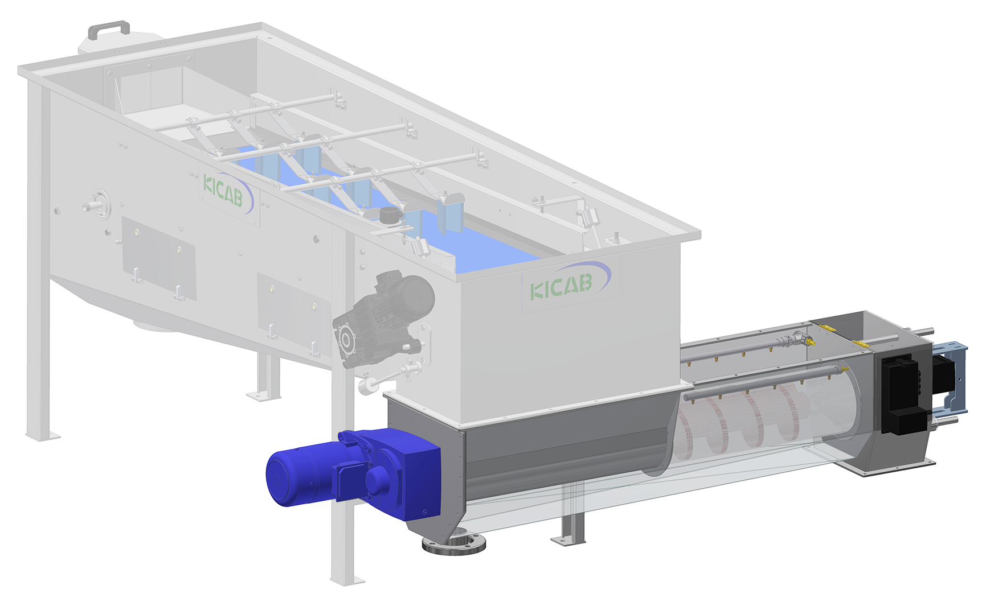
Exit
SALTEC Screw Press - KSP
High-performance and innovative product that is developed and dimensioned for hard loads with high efficient dewatering.
Features
Effective dewatering, transportation and minimizes wear.
Easy rinse and maintenance.
Minimizes the risk of clogging.
Bristled spiral during drainage.
Enables easy replacement of pressure pipes.
Enables adjustments of the dewatering rate.
Thickener units
Dewatering units
Polymer units
Overview
Tech Spec

Slide 25
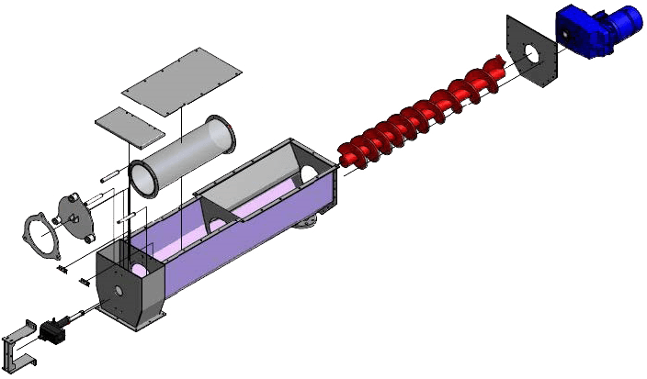
Exit
SALTEC Screw Press - KSP
Technical Specifications
3)
Width
2)
1)
4)
5)
Length
Height
6)
1) Filter / Matrix 2) Spiral unit 3) Drive unit 4) Sliding shaft
5) Shaft bushing 6) Hinge 7) Actuator
Model | Length [ mm ] | Width [ mm ] | Height [ mm ] | Capacity [ m3/h] | DS-Out [ % ] | Power [ kW ]
KSP 1 | 2800 | 700 | 1250 |  | 4 – 12 | 0,55
KSP 2 | 2800 | 800 | 1250 | 1 – 10 | 4 – 12 | 0,55
KSP 3 | 2800 | 1000 | 1250 | 10 – 25 | 4 – 12 | 0,55
7)
Thickener units
Dewatering units
Polymer units
Overview
Tech Spec

Slide 26
Exit
Double Tank System - DT
Mixes and stores powder polymer solution through a separated two tank system.
Powder polymer is transported by air which gives maximum wetting efficiency in the PolyWet eductor
Features
Compact, Automatic, Hygienic, CE approved.
Polywet PPW & separate tanks ensures homogenous active solution.
Big inspection hatches for easy access.
Octagonal tanks for optimum mixing.
Entirely from thick stainless steel incl stainless full flow valves & pipes.
Thickener units
Dewatering units
Polymer units
Overview
Tech Spec
Flow Chart

Slide 27
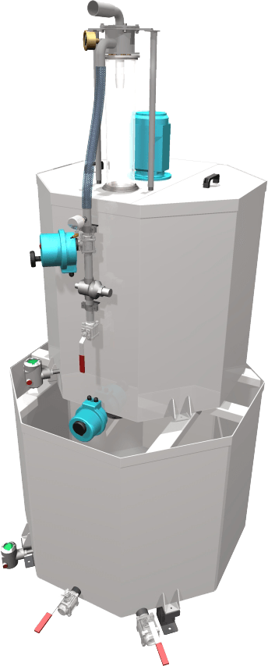
Exit
Double Tank System - DT
Technical Specifications
Polymer inlet
Manometer
PolyWet eductor
Mixer
Inspection hatch
Width
Model | Length [ mm ] | Width [ mm ] | Height [ mm ] | Tank volume [ l ] | Capacity [ kg/h ]
DT 0303 | 1050 | 875 | 2330 | 600 | 0,9
DT 0505 | 1250 | 1000 | 3000 | 1000 | 1,4
DT 0709 | 1500 | 1250 | 3000 | 1600 | 2,1
DT 1317 | 1750 | 1500 | 3250 | 3000 | 4
DT 2030 | 2250 | 2000 | 3500 | 5000 | 5,5
DT 3040 | 2250 | 2000 | 4250 | 7000 | 9,1
DT 4050 | 2250 | 2000 | 4750 | 9000 | 11,4
DT 6060 | 2500 | 2250 | 5050 | 12000 | 17,5
DT 80100 | 2500 | 2500 | 5550 | 18000 | 23
Flow switch
Ball valve
Water inlet
Preparation Tank
Tank level control
Height
Throttle valve
Storage
Tank
Tank level control
Length
*Approximately data at 0.3% concentration
Drain valve
Overflow protection valve
Thickener units
Dewatering units
Polymer units
Overview
Tech Spec
Flow Chart

Slide 28
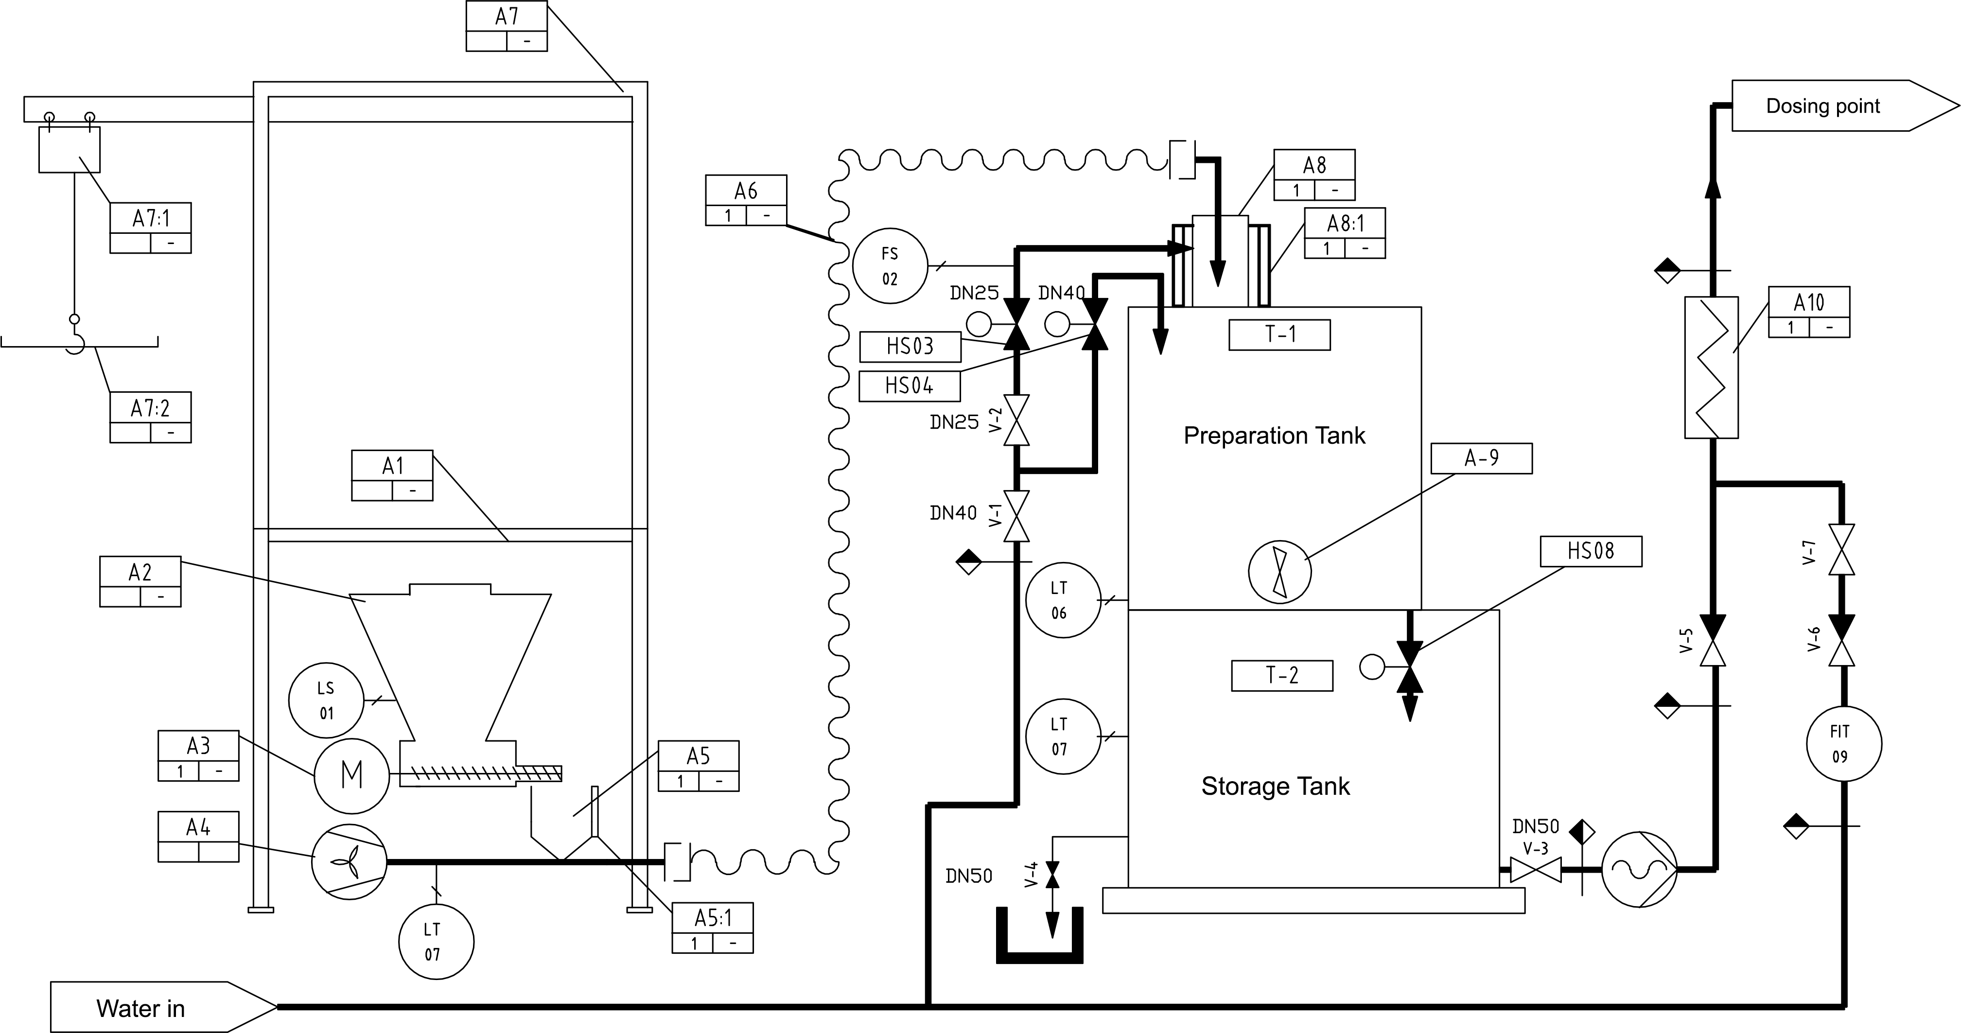
Exit
Double Tank System - DT
Flow chart
Thickener units
Dewatering units
Polymer units
Overview
Tech Spec
Flow Chart

Slide 29
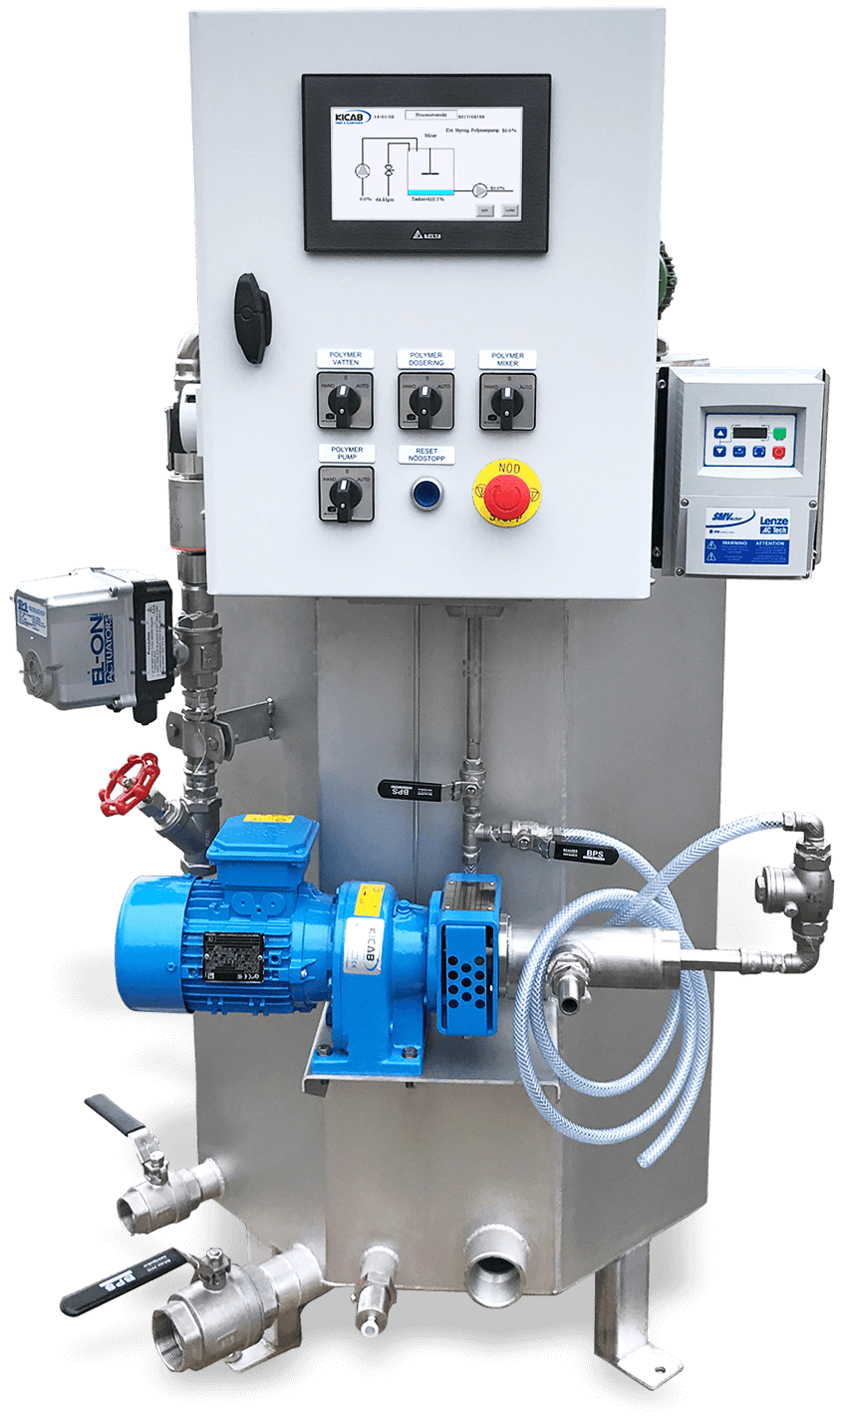
Exit
Liquid Polymer System - LPS
LPS mixes and stores liquid emulsion polymer solution continuously through a simple effective double tank system.
Features
Compact, Automatic, Hygienic, CE approved.
Easy maintenance and accessibility.
Fully enclosed ventilated system to eliminate aerosol and odour.
Low consumption of resources - Polymer, Energy, Water.
Effective design and manufacturing with the best materials available.
High quality equipment completely in stainless steel.
Thickener units
Dewatering units
Polymer units
Overview
Tech Spec
Flow Chart

Slide 30
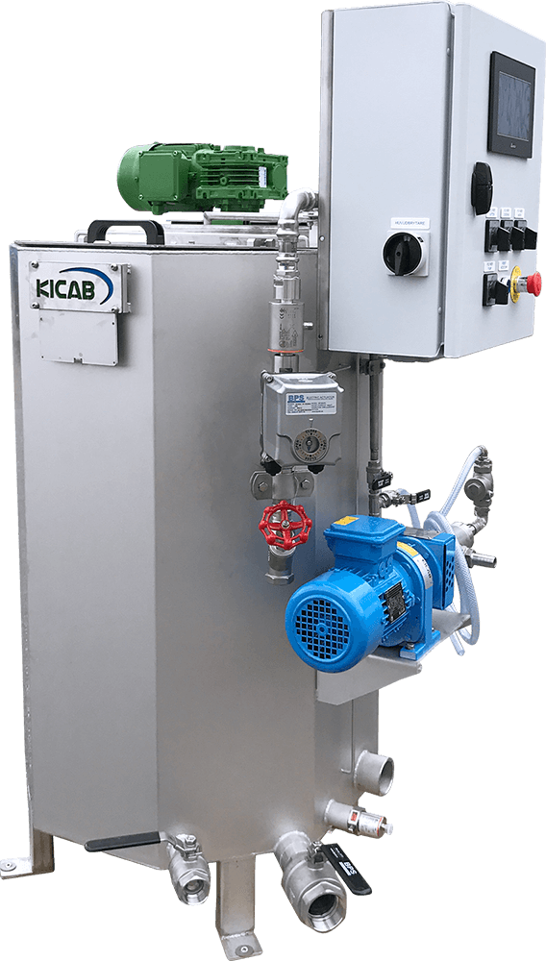
Exit
Liquid Polymer System - LPS
Technical Specifications
Mixer
Control cabinet
Flow meter
Motor ball valve
Throttle valve
Concentrate pump
Water inlet
Overflow protection Outlet
Model | Length [ mm ] | Width [ mm ] | Height [ mm ] | Tank vol. [ l ] | Dosing vol. [ l/h ] | Capacity [ kg/h]
LPS 3 | 960 | 750 | 1400 | 300 | 1750 | 9
LPS 5 | 1220 | 1100 | 1400 | 500 | 2750 | 12
LPS 10 | 1580 | 1450 | 1400 | 1000 | 6000 | 25
Level control
Polymer discharge outlet
Drain valve
*Approximate data at 1% concentration
Thickener units
Dewatering units
Polymer units
Overview
Tech Spec
Flow Chart

Slide 31
Exit
Liquid Polymer System - LPS
Flow chart
Thickener units
Dewatering units
Polymer units
Overview
Tech Spec
Flow Chart

Slide 32
Exit
Small Bag System – Suction unit
Small bag system with screw feeders, powder transport blower and Heated cone with venturi ejector or patented AeroWet.
Features
Compact, Automatic, Hygienic, CE approved.
Heated Cone with venturi ejector developed for Polywet PPW wetter.
Frame, Powder pocket, Heated cone and Screw feeders in stainless steel.
Internationally long-term proven construction.
Thickener units
Dewatering units
Polymer units
Overview
Tech Spec

Slide 33
Exit
Small Bag System – Suction unit
Technical Specifications
A
B
C
D
Model | Capacity [ kg ] | Width [ mm ] | Depth [ mm ] | Frame Height [ mm ] | Total Height [ mm ]
SE-100 | 100 | 770 | 770 | 850 | 1500
SE-150 | 150 | 770 | 770 | 850 | 1650
SE-200 | 200 | 770 | 770 | 850 | 1800
SE-250 | 250 | 770 | 770 | 850 | 1950
SE-300 | 300 | 770 | 770 | 850 | 2100
D
A
B
C
Thickener units
Dewatering units
Polymer units
Overview
Tech Spec

Slide 34
Exit
Continuous Polymer System - CPS
A patented design that mixes and stores powder polymer solution continuously with a vertical dissolving technology.
Technology that enables a single tank with half of the volume requirement compared to a conventional two-tank system.
Features
Vertical dissolution technology with single tank operation.
Automatic operation. Requires only replenishment of polymer.
Storage tank or transfer pump is not required.
Modular design allows the powder handling to be installed in dry rooms.
Automatic wetting system incorporating the famous PolyWet® disperser.
Handles variable process water quality without tank sedimentation.
Dedicated control panel to accommodate customer special requirements.
Thickener units
Dewatering units
Polymer units
Overview
Tech Spec

Slide 35
Exit
Continuous Polymer System - CPS
Technical Specifications
Dispersion Control
Un-aged 1st Contact
Pressure Switch
Flow Restrictor
Water Solenoid Valve
Dissolution Control
PolyWet Head
Water Control
Level Sensor
Flow Restrictor
Water
Fully Aged Homogeneous Solution
Powder Feed Control
Powder Pocket
Model | Length [ mm ] | Width [ mm ] | Height [ mm ] | Weight [ kg ] | Tank volume [ l ] | Capacity* [ kg/h]
Feeder module | 5045 | 2055 | 2150 | 250 | 45
CPS 2 | 5045 | 2305 | 2150 | 700 | 2000 | 7
CPS 6 | 5045 | 2555 | 2150 | 1150 | 6000 | 17
CPS 12 | 5045 | 2855 | 2150 | 2500 | 12000 | 32
CPS 25 | 5045 | 3255 | 2150 | 4200 | 25000 | 70
Screw Feeder
Blower
FEEDER UNIT
MIXING UNIT
*Approximate data at 0.3% concentration and an average maturation time of 60 min.
Thickener units
Dewatering units
Polymer units
Overview
Tech Spec

Slide 36
Exit
PolyWet eductor
As the fan is transporting the powder, the powder-particles spreads before it reaches the eductor and a more homogeneous solution is already formed in the preparation tank.
1
8
# | Qty | Description
1 | 4 | Manometer 6 bar
2 | 4 | Screw
3 | 4 | Nut M6S 8
4 | 8 | Tray R8, 8x15x1.6
5 | 1 | Nozzle WEEJET 4080
6 | 1 | Teflon tip (Standard)
7 | 1 | PolyWet Glass
8 | 1 | PolyWet Clamp
2 3 4
7
5
6
Thickener units
Dewatering units
Polymer units
Polymer options
Overview

Slide 37
Exit
Diluting Water Board
KICAB’s diluting water board is used for dilution of the
polymer or other chemicals to a lower concentration for
a better and easier mixing of the media.
Size | Range | Connection | Material
DN25 | 150 – 1500 l/h | DN25 inv thread | Stainless steel
DN32 | 250 – 2500 l/h | DN32 inv thread | Stainless steel
DN50 | 600 – 6000 l/h | DN50 inv thread | Stainless steel
DN25 | 150 – 1500 l/h | DN25 inv thread | PVC
DN32 | 250 – 2500 l/h | DN32 inv thread | PVC
DN50 | 600 – 6000 l/h | DN50 inv thread | PVC
1. Mixing elements
2. Union coupling
3. Check valve polymer
4. Check valve dilution water
5. Adjustable valve
6. Rotameter
7. Cone mixing elements
Thickener units
Dewatering units
Polymer units
Polymer options
Overview

Slide 38
Exit
Heated cone with venturi injector V2
A
The ejector with heated cone V2 is special designed for the transport of powder polymer from the dispenser to the PolyWet®-eductor.
B
C
D
E
F
# | Qty | Description
A | 1 | Heated cone
B | 1 | Inlet venturi injector
C | 1 | Pipe from heated cone to ejector
D | 1 | Outlet to PolyWet via blowing hose
E | 2 | Hose clamp 32-44
F | 1 | Rubber hose DN32
Thickener units
Dewatering units
Polymer units
Polymer options
Overview

Slide 39
Exit
Eductor for Polymer
Used to dissolve the polymer in liquid or powder form. It’s designed to give a good solution at a low cost.
Provides a complete wet-out of polymer and other “difficult” materials.
Eductor - PVC
Eductor - Stainless steel
Funnel
for powder polymer
Tube
for liquid polymer
Eductor body
Connection
for mixing water
Thickener units
Dewatering units
Polymer units
Polymer options
Overview

Slide 40
Exit
AeroWet™
A standalone device with a powder hopper of 45-800kg, screw feeders, fan, receiver unit after the feeder, pressure monitor and control cabinets.
Heating mat for AeroWet™
Prevents moisture and lumps in powder polymer
AeroWet™
Features
Revolutionary design for a dustproof polymer dosage.
Fully automatic operation.
Modular construction of feeder, preparation and storage-vessels.
Eliminates powder clogging that's normally associated with polymer venturi system.
Superior process quality with a consistent, repeated and lump-free polymer solution.
Polymer is fed from the storage hopper with a constant rate via the AeroWet™-module through an air flow, created by the blower.
The air transports the powder to the PolyWet-eductor where its mixed with water before it reaches the mixing tank.
Thickener units
Dewatering units
Polymer units
Polymer options
Overview

Slide 41
Exit
Sludge sled
The Sludge sled is used with Thickeners model SBT for increased DS-content.
Can also be used on other Belt Thickener models than ours.
Screwable nut
(tighten for lower DS-content)
Spring
Upper bushing
Threaded rod
Adjustable height track, Sled
(Up = Lower DS)
(Down = Highter DS)
Lower bushing
Thickener units
Dewatering units
Polymer units
Thickener options
Overview

Slide 42
Exit
Polymer Flange with Divisive
KICAB polymer flange with associated polymer divisive
ensure consistent and effective mixture of the polymer in the
streaming media pipeline construction.
Polymer divisive
DN20
DN10
Polymer flange | D [ mm ] | K [ mm ] | DN [ mm ] | H | T [ mm ] | A2
DN50 | 165 | 125 | 50 | 18x4 | 48 | DN10
DN65 | 185 | 145 | 65 | 18x4 | 48 | DN10
DN80 | 200 | 160 | 80 | 18x8 | 48 | DN10
DN100 | 220 | 180 | 100 | 18x8 | 48 | DN10
DN125 | 250 | 210 | 125 | 22x8 | 48 | DN10
DN150 | 285 | 240 | 150 | 22x8 | 48 | DN10
KICAB polymer flange and divisive are usually used just before KICAB sludge mixer.
Polymer flange
Thickener units
Dewatering units
Polymer units
Thickener options
Overview

Slide 43
Exit
Sludge mixer
KICAB Sludge mixer optimizes the mixture of organic and inorganic flocculants and watery suspensions of different concentration.
Size | Flow [ m3/h ] | L | H | D | D1 | HD | h1 | E | T
DN50 | 1 – 15 | 340 | 137.5 | 50 | 165 | 125 | 18x4 | 115 | 8
DN80 | 15 – 35 | 295 | 162 | 80 | 200 | 160 | 18x4 | 140 | 10
DN100 | 35 – 80 | 490 | 192 | 100 | 220 | 180 | 18x8 | 159 | 8
DN150 | 80 – 120 | 430 | 250 | 150 | 285 | 240 | 22x8 | 180 | 10
Can also be mounted in where different media streams is to be mixed before flocculation agent is added.
Thickener units
Dewatering units
Polymer units
Thickener options
Overview

Slide 44
Exit
SALTEC Dynamic Mixer - KDM
Dynamic Mixer provides complete mixing of chemicals in thick sludge or advanced mixing applications.
Features
Compact, Automatic, Hygienic, CE approved.
Optimal for biogas applications.
High mixing energy increases chemical efficiency significantly.
Completely in sturdy stainless steel.
Completely redesigned in international multi-year proven technology and patents.
Model | Length [ mm ] | Capacity [ m3/h ] | Inlet / Outlet | Conn. Chem.
DN8 | 1200 | 15 | DN80 | DN20
DN10 | 1300 | 25 | DN100 | DN20
DN15 | 1400 | 50 | DN150 | DN25
Thickener units
Dewatering units
Polymer units
Thickener options
Overview

